Slide 1
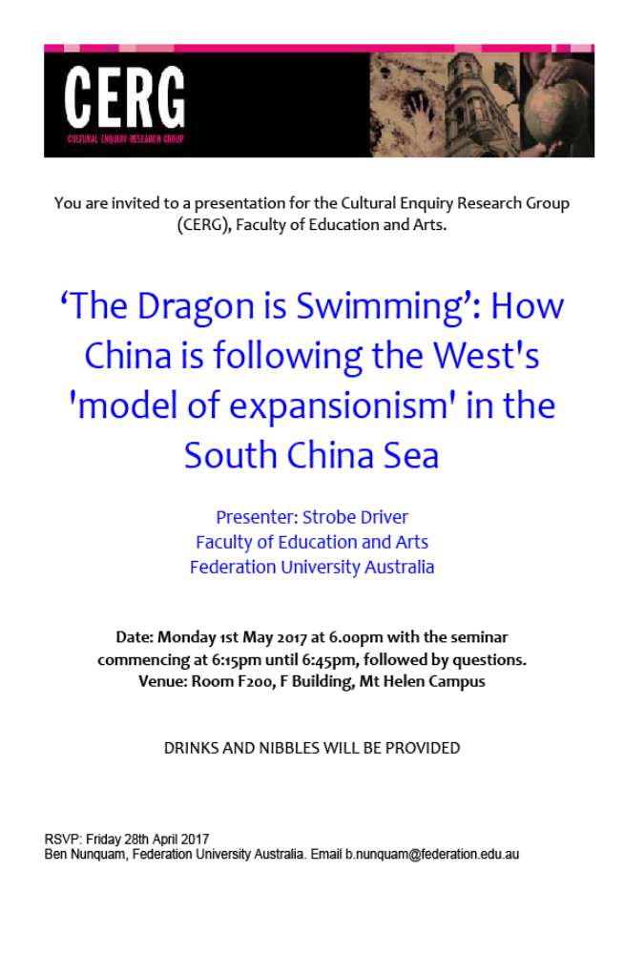
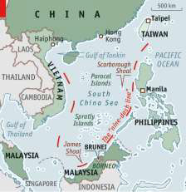
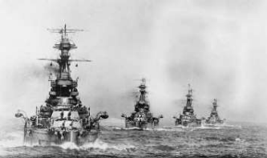
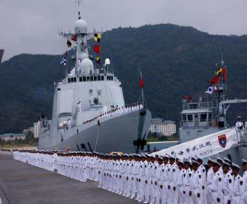
Dr Strobe Driver
Adjunct Researcher: Federation University
Seminar Synopsis:
Since time in memoriam nation-states have exerted power through the use of naval fleets which has
allowed for a robust response to ‘threats.’ Approximately twenty years ago under the direction of
Deng Xiaoping the People’s Republic of China (PRC) government established a vision: China would in
the future become one of the ‘poles’ in a multi-polar geo-strategic world.
The vision that China sought in the mid-1990s has been incrementally and exponentially increased to
the point of becoming a reality. China has begun the process of becoming a superpower by firmly
establishing what the PRC deems to be China’s ‘rightful place’ in the Asia-Pacific. In the last
decade China has sought to establish its territorial claims, whether they be with an historical
element such as claiming the Senkaku/Diaoyu Islands, or with a more straightforward component of
insisting their immediate territorial waters have expanded beyond what was previously ‘accepted.’
This reflects the geo-strategic ‘creep’ that is at play; the newfound confidence of the People’s
Liberation Army Navy (PLAN); and the nationalistic agenda that is fomenting in the Chinese
populace.
The establishment of the ‘nine-digit line’ an increased naval presence by the PLAN in the
Asia-Pacific region; long-range patrols, or the establishment of a ‘blue-water’ navy; the
non-acceptance of international law and navigation rights by the PRC; the beginnings of a
fleet-air-arm program and the establishment of a corresponding battle fleet; and the building of
fortified bases on atolls in the South China Sea. These are instances of the ‘dragon beginning to
swim’ further and further from its shores. This paper will examine the rise of modern China and the
ways in which it is mirroring the development of Western states as a superpower.
Image credits (left to right):
Anon. (c. 1918). R Class Battleships in Line Ahead, [photo], Portsmouth, U.K.: National Museum of
the Royal Navy.
Zha Chunming. (2008). Untitled [ceremony before a Chinese naval fleet sets sail from Sanya,
Hainan], [photo], Xinhua News Agency.
Anon. (2012). Having it both ways [image, Nine-dash-line], Banyan column, The Economist.
Strobe Driver completed his doctoral thesis on war studies in 2010. Since then he has written
extensively on war, terrorism and Asia-Pacific security. After a decade-plus of being a lecturer
and tutor at Federation University he is currently an adjunct researcher at the university, and is
continuing to write on the aforementioned subjects.

Slide 2
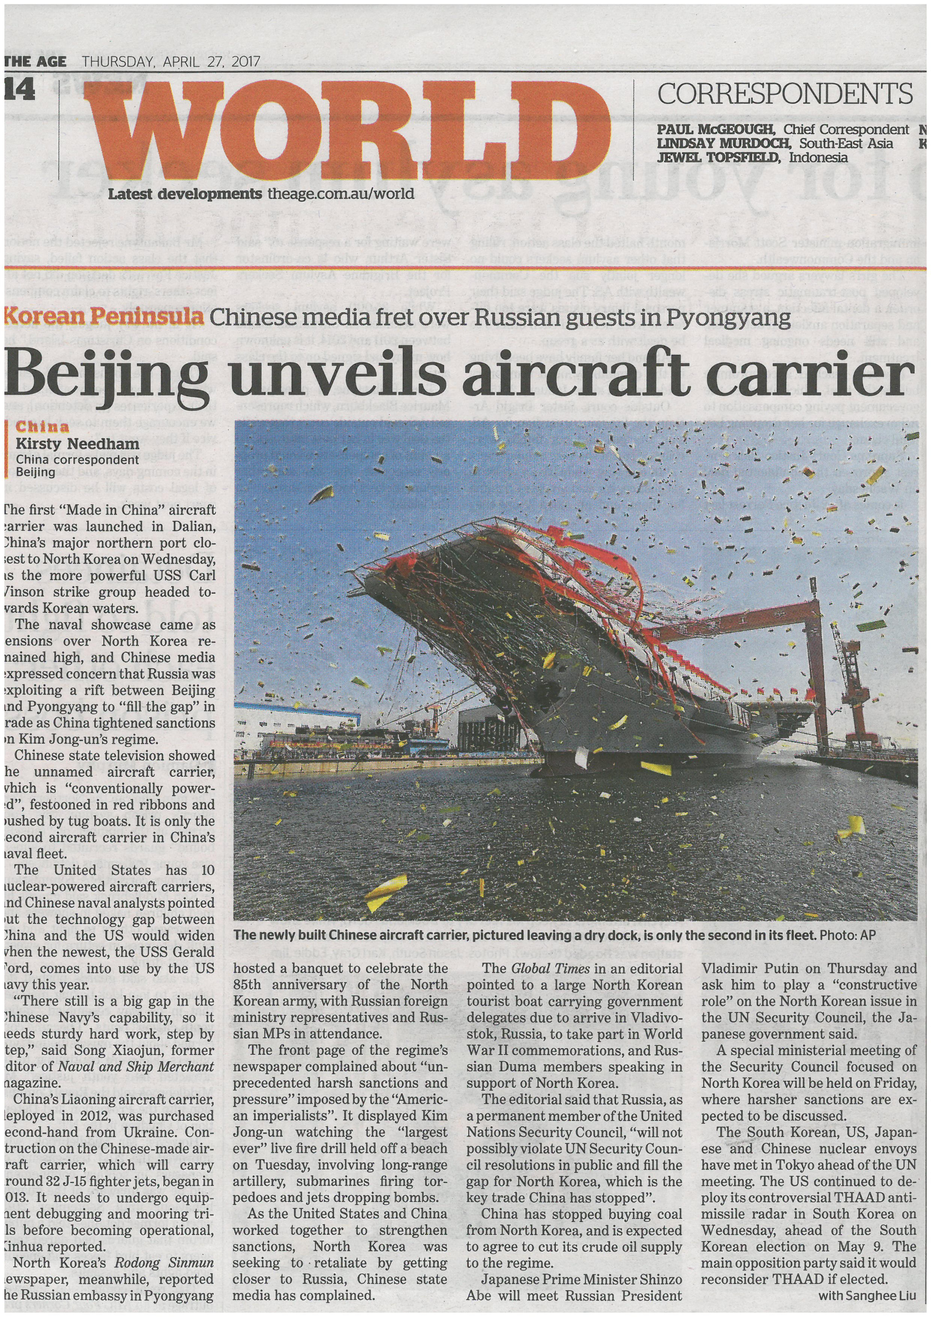
On cue …

Slide 3
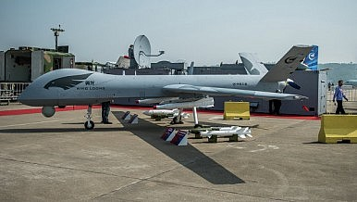
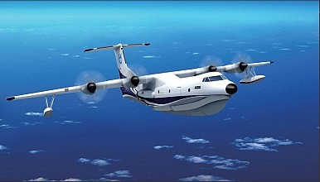
Be assured, the Dragon is also flying (as Dragons ‘are supposed to do’):
China to Sell Saudi Arabia Drones
China and Saudi Arabia have agreed on a deal for the Wing Loong medium-altitude long-endurance UAV.
See: Zachary Keck, The Diplomat, 8 May, 2014.
http://thediplomat.com/2014/05/china-to-sell-saudi-arabia-drones/
Confirmed: Beijing is Building World’s Largest Sea Plane for Use in South China Sea
The new plane will be able to execute a host of military assignments.
See: Franz-Stefan Gady. The Diplomat, 23July, 2015.
http://thediplomat.com/2015/07/confirmed-beijing-is-building-worlds-largest-sea-plane-for-use-in-south-china-sea/

Slide 4
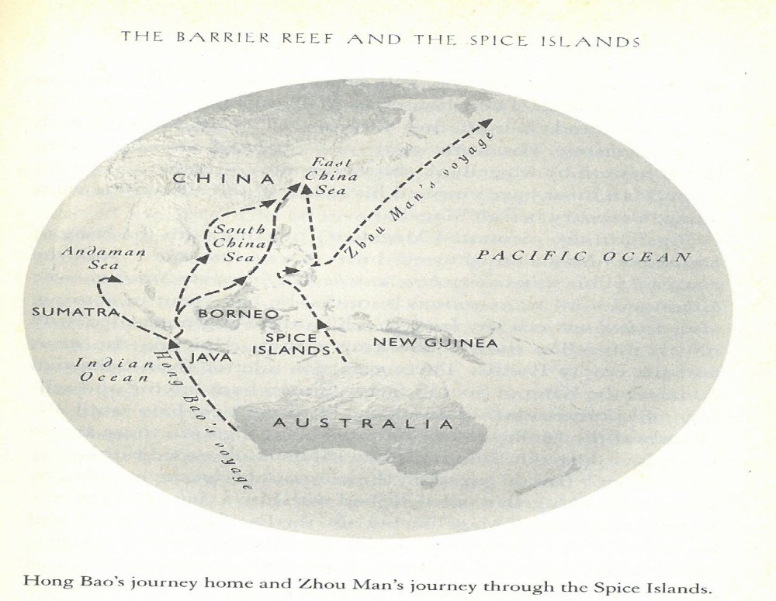
Gavin Menzies. 1421 The Year China Discovered America. Great Britain: HarperPerennial, 2002, 231.

Slide 5
What China has ‘lost’ and what it wants reclaimed …
During the Qing Dynasty [1644 – 1912] the [S]tate was proactively involved through an investment programme in agricultural improvement, irrigation and waterborne food transportation … Chinese urban centres were more developed than their corresponding European cities. The wealth of major cities and the level of craftsmanship amazed many first-time European travellers to China. In the sphere of scientific discoveries and application to production processes, China was at the forefront of modernization …
… paper, gunpowder and the magnetic compass would change the world …
See: Jacques Hersh. ‘The Eastern Wind Will Not Subside: China’s Long March Back to the Future?’ The Rise of China and the Capitalist World Order. Edited Li Xing. Burlington: Ashgate Publishing, 2010, 27. Emphasis mine, colour mine.

Slide 6
A navy and what it ‘means’
Powerful nation-states, with a strong navy from an historical perspective:
Portugal, Spain, France, Japan, Great Britain, United States of America have all been (and some still are in varying degrees) a great naval presence
China is now seeking to establish a forthright naval presence
How does this happen, and how is it measured?

Slide 7
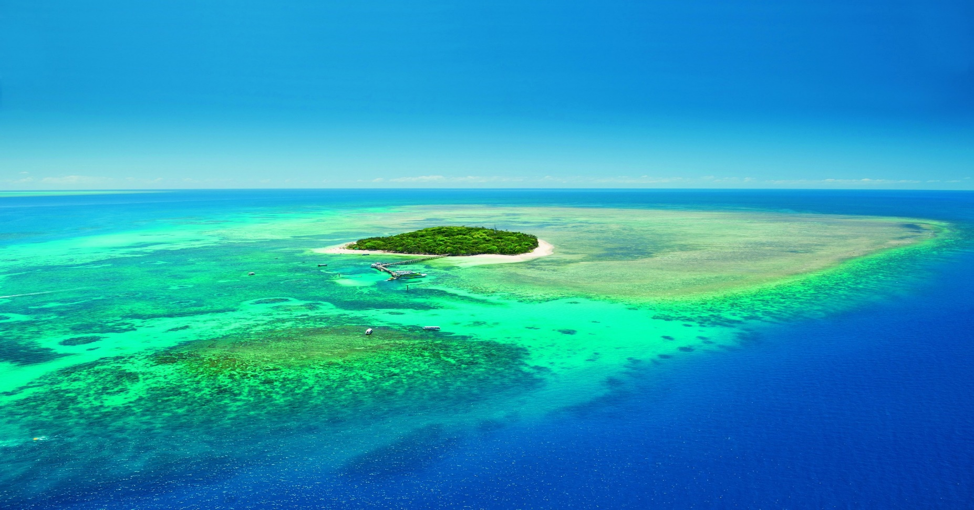
This image is able to represent a ‘green to blue’ scenario a littoral navy progressing to a ‘blue water’ navy
Photo credit: https://www.queensland.com

Slide 8
How does a navy ‘control’ …
There are essentially three ‘types’ of deployment that a navy carries out
Littoral – green water
Ocean going – blue water (high seas)
Brown water – inlet/s, river/s (gun boats)

Slide 9
Patricia Seed. ‘The Conquest of the Americas 1500 - 1650.’ The Cambridge History of Warfare. Edited by Geoffrey Parker . Cambridge: Cambridge University Press, 2002, 135.

Slide 10
Why/how does this happen?
Some key aspects which are relevant though are not limited to:
An Industrial Revolution;
A growth in the middle-classes (545m+, in a decade);
An exponential growth in nationalism/patriotism;
An increased regional and/or international presence;
A quest for redefinition (of their history);
A reinvigoration of past ‘wrongs’;
A renewed focus on (and of), their of current ‘status’; and
A political - military - physical presence.

Slide 11
A more involved China
Under the auspices of the United Nations (UN) anti-piracy acts/resolutions, the PLAN was off the coast of Somalia in the mid- to late-1990s
A strong and focussed presence at the UNSC which involved refusing to acknowledge Japan as a ‘P6’
The establishment of the Nine-digit-line (1947 - ) backed up with force
Statements regarding sovereignty and historical roots being reaffirmed
Dismissing UN rulings
Pressure on neighbours (Exercise Malabar)

Slide 12
China: ‘if the West can do it for so long, why can’t we?’
The West and its involvement in other countries
Robust and strong ongoing claims made by the West under the guise of ‘promoting democracy,’ ‘human rights’ and other platitudes and mantras and the mendacity therein, e.g., Singapore, Saudi Arabia, Kuwait…
The non-return/recognition of lands claimed or inhabited by Western quasi-Colonial forces (Ghana, Ivory Coast, Islas Malvinas/Falkland Islands, Diego Garcia, Guam, Hawaii, Okinawa, Djibouti Brunei …)

